Slide 1

MIH
MANGGALA INTERNATIONAL HOSPITALITY
PT. MANGGALA INTERNATIONAL HOSPITALITY

Slide 2
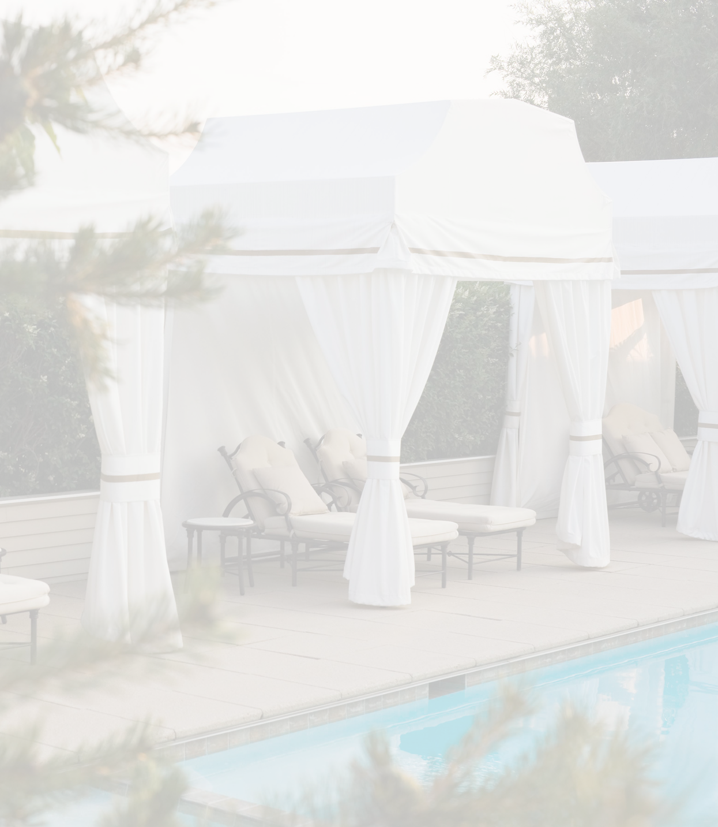
ABOUT US
We believe our value makes us who we are. Our success will firmly established by
Putting customers first has always been our priority in term of executing our code of business conducts. Moreover, we emphasize on
exceeding guest expectation and willingness of going extra miles.
the pursuit of excellence in all aspect by working hard and upholding our values of genuine and teamwork. To top all that, we strongly believe in implementing integrity and stay humble in every success we achieve.
BE A PART OF MANGGALA INTERNATIONAL HOSPITALITY – A PROUD OF THRIVE EXCELLENCE CULTURE

Slide 3

VISION, MISSION, AND VALUES
OUR VISION OUR MISSION OUR VALUES
Becoming the leading hospitality management company recognized for its genuine services
Inspire our people and partners to be their best. Exceed guest expectation
Attain highest level of operational effectiveness and cost efficiency
Integrity Genuine Teamwork Hard Working Humble

Slide 4
OUR ORGANIZATION CHART
Commissioners
Chief Executive Officer
Chief of Human Capital & General Affair
Chief of Finance
Chief of Food and Beverage
Chief of Digital Marketing

Slide 5
OUR SERVICE
Manggala International Hospitality, We offer Hotel Management and Revenue Management Services for Resorts, Villas and Hotels with innovative concept to manage the property with corporate compliance.
Area of expertise of our hospitality management team include:
Hotel Operations Digital Marketing
Revenue Management Human Capital
Finance & Cost Control Spa Management
Restaurant Management
Branding & Positioning
Pre-Opening Management

Slide 6

OUR BRANDS
Premium Collection
RESORT
Boutique Collection
SUITES & VILLA
Essentials Collection
HOTELS

Slide 7
OUR BRANDS
RESORT
Resorts Brand Identity
PREMIUM
For every single one of our guest, we treat them as part of our big family to share happiness, laughter and beautiful moment
Combine innovative design, crafted luxury and unprecedented level of personalize
hospitality and service
to create for our
HOTELS
together. To stay at our resorts is to embark on a destination of experience. Be it in creating the flavours of the local
extraordinary experiences
valuable guest so they can feel the joy of living the present moment to the fullest.
cuisine, enchanting your well-being through ancient healing art.
“Home is where you feel at home and are treated well” - Dalai Lama

Slide 8
OUR BRANDS
SUITES & VILLAS
Suites & Villas Brand Identity
BOUTIQUE
A traditional elements of privacy, beautiful landscape garden, same exquisite design philosophy into interior designing aspect to achieve a cohesive look from the exterior to
interiors._{HOTELS}
Personalized service provided by the staffs goes above and beyond satisfying the guest needs becomes another utmost point to distinguish from other Suites or Villas.
“You can’t create experience. You must undergo it” - KK

Slide 9
OUR BRANDS
HOTELS
Hotels Brand Identity
ESSENTIAL
Compact and yet intimate situated in a fashionable prime location. It is held in Chick – Design décor with a personal note to create a unique character withe a sense of intimacy and privacy to distinguish itself from other hotel brands.
Being true to its origin concept, our hotels provides a great and ultra personalized service for its distinguished guests.
“Simplicity is the intimate sophistication” - Leonardo da Vinci

